Slide 1
Visual Studio Mobile Center

Slide 2
Building an App with Azure Wifi: MSFTGUEST Pw: msevent42pz

Slide 3
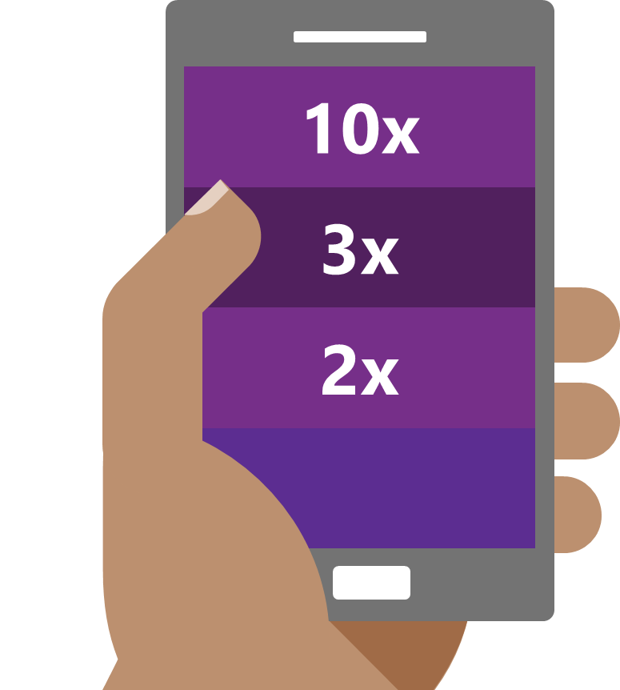
The Need : Mobile has happened
Faster than the PC boom of the 80s
Faster than the recent social networking explosion
Faster than the Internet boom of the 90s
Source: Flurry Analytics (link)
Notes:
The revolution will not be televised – it will be mobile. is not “coming” or “under way”, it has already happened!
And the mobile tidal wave proved to be faster and bigger than anything that came before it.
Mobile is a key part of our customers' digital transformation.
Aside from consumer apps, organizations are mobilizing their workforce and partners with a growing number of critical business apps.
The lower consumer price point of technology has made it ubiquitous – not just in the US – but in the world. In Kenya – they have leapfrogged

Slide 4
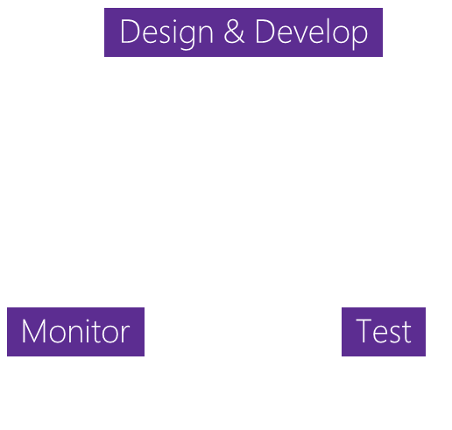


The Challenge: App development challenges
SCALE
COMPLEXITY
FRAGMENTATION
Design & Develop
Monitor
Test
100+ apps
Businesses need to rapidly build and deliver high-quality mobile apps
App Delivery
The lifecycle to deliver ‘just one’ app involves many stages
1000+ Devices
Mobile ecosystems are complex with many combinations of devices
Notes:
In todays world, many businesses have already started built their first initial apps, typically targeting mobile devices, whether for internal use or customer facing. Soon 1 app turns to 10, or 100, as they being to realize that in order to be successful and thrive in todays market they will have to support not just one mobile app but a multi-app mobile strategy.
We call this concept the appification of your business. As one app turns to many, in introduces greater complexity in the development process as you try to iterate, develop and maintain this suite of apps.
Finally, app development is difficult, as you have to target a large number of device configurations to reach your audience.

Slide 5



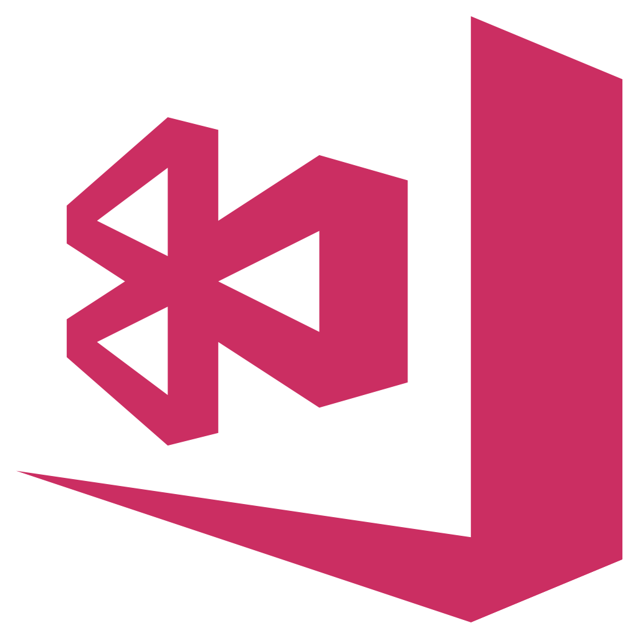
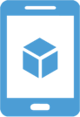

HockeyApp
Xamarin Test Cloud
Xamarin Insights
Distribution • Crashes • Analytics
Device Tests
Crashes • Analytics
Visual Studio Mobile Center
Azure Mobile Engagement
Azure App Service
CodePush
Analytics • Push
Tables • Auth • Push
Distribution
Notes:
Talk about how our teams and product came together.
We’ve taken these Microsoft products which are leading services in their specific part of the mobile development lifecycle and we’ve brought it all together. Into Visual Studio Mobile Center. A mission control for all your apps. A place where all these service seamlessly integrate to make the cycle easier and faster for developers. Developers of all kinds regardless of which platforms their developing for. The value of Mobile Center is reaching developers who aren’t our typical Microsoft customers by providing the highest quality services in the smoothest configuration. We’re giving them an end-to-end solution where they can use all of it or pick what they want, all while driving Azure attachment.

Slide 6
Visual Studio Mobile Center
Continuous everything
Crash Reporting
Live Update
Push Notifications
Notes:
Key points:
This is why we’ve built Mobile Center – your mission control for apps
Mobile Center has everything you need to build great mobile apps, fast
You get the time and the insights to focus on what users want

Slide 7
Visual Studio Mobile Center
Automate entire app lifecycle
Flexible, open platform and modular SDKs
Support for Obj-C, Swift, Java, React Native, and Xamarin apps
A mobile-optimized front door for Azure App Service
The next generation of Xamarin Test Cloud, HockeyApp, and CodePush
Notes:
In just a few minutes, you can connect your apps to complete set of lifecycle services: continuous integration, automated testing, distribution, engagement, crash reporting, and analytics, as well as a mobile-optimized front door into Azure cloud services.
The upshot? Release higher quality apps faster. Build quality into the process by embedding automated UI tests into your build and release pipeline, then get integrated crash and analytics data on your apps in the wild. So you can spend more time on apps and less time on opps. Focus on innovation
And we don’t want to displace things that already work for you. We work with iOS, Android, and UWP apps written with Objective-C, Swift, Java, React Native, or Xamarin. If you don’t want to use the whole Mobile Center suite right now, you can pick just the services you want. The platform is completely open and modular, and every feature is available through an API.

Slide 8
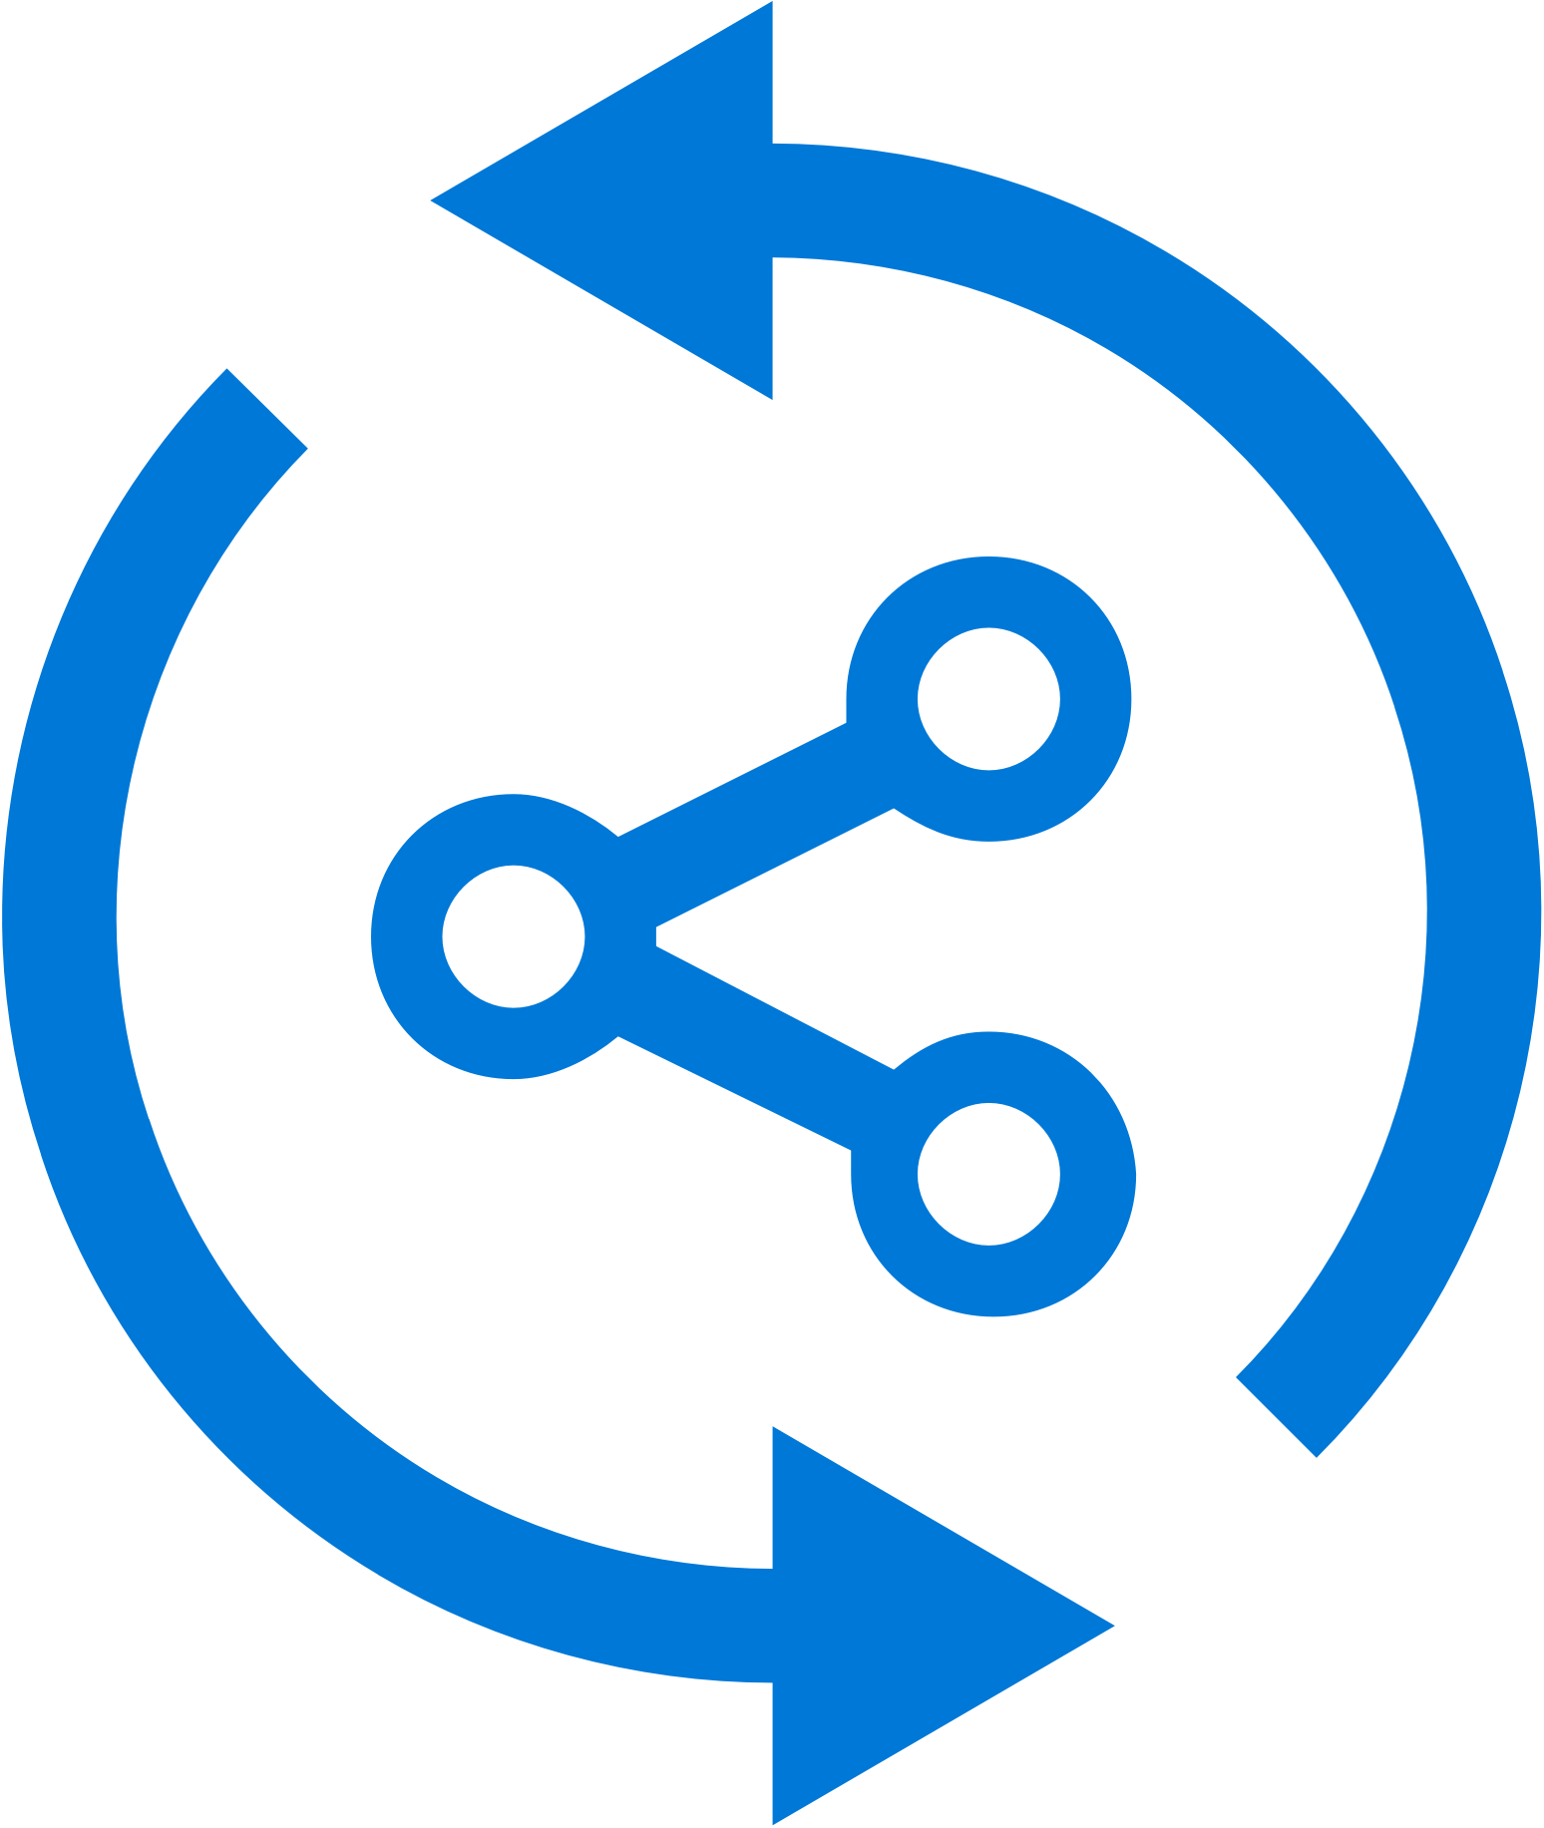


Continuous Everything: Build
Build-on-push
With just a few steps automatically build apps with every commit, and generate packages to test and distribute
Work with existing tools
Connect existing repositories in GitHub, Bitbucket, and Visual Studio Team Services with just a few clicks
Build securely in the cloud
Each build is run on a separate, clean virtual machine hosted on our secure cloud servers
Notes:
The Build functionality allows you to connect your existing code repositories, like VSTS, GitHub and BitBucket and configure them to run automatically on code submission, or on a timed schedule, regularly staying up to date on the health of your build. This is all done on the cloud, so you don’t have to manage any hardware locally.

Slide 9


Continuous Everything : Test
Release faster
Shrink release times significantly and push new apps out faster
Ship high quality apps Ensure the highest quality user experience that keeps users continuously engaged
Engage a broad audience
Test on a broad range of devices to make sure apps work on your users’ devices
Notes:
Along with Build, you App Center also has a device lab with over 300 configurations of Android and iOS devices that you can run your developed UI Automation scripts. We support scripts written in a variety like UITest, Appium or the native Espresso and XCUITest. Run your app on real devices without, again, maintaining the hardware, and getting live results to know your app is bug free.

Slide 10
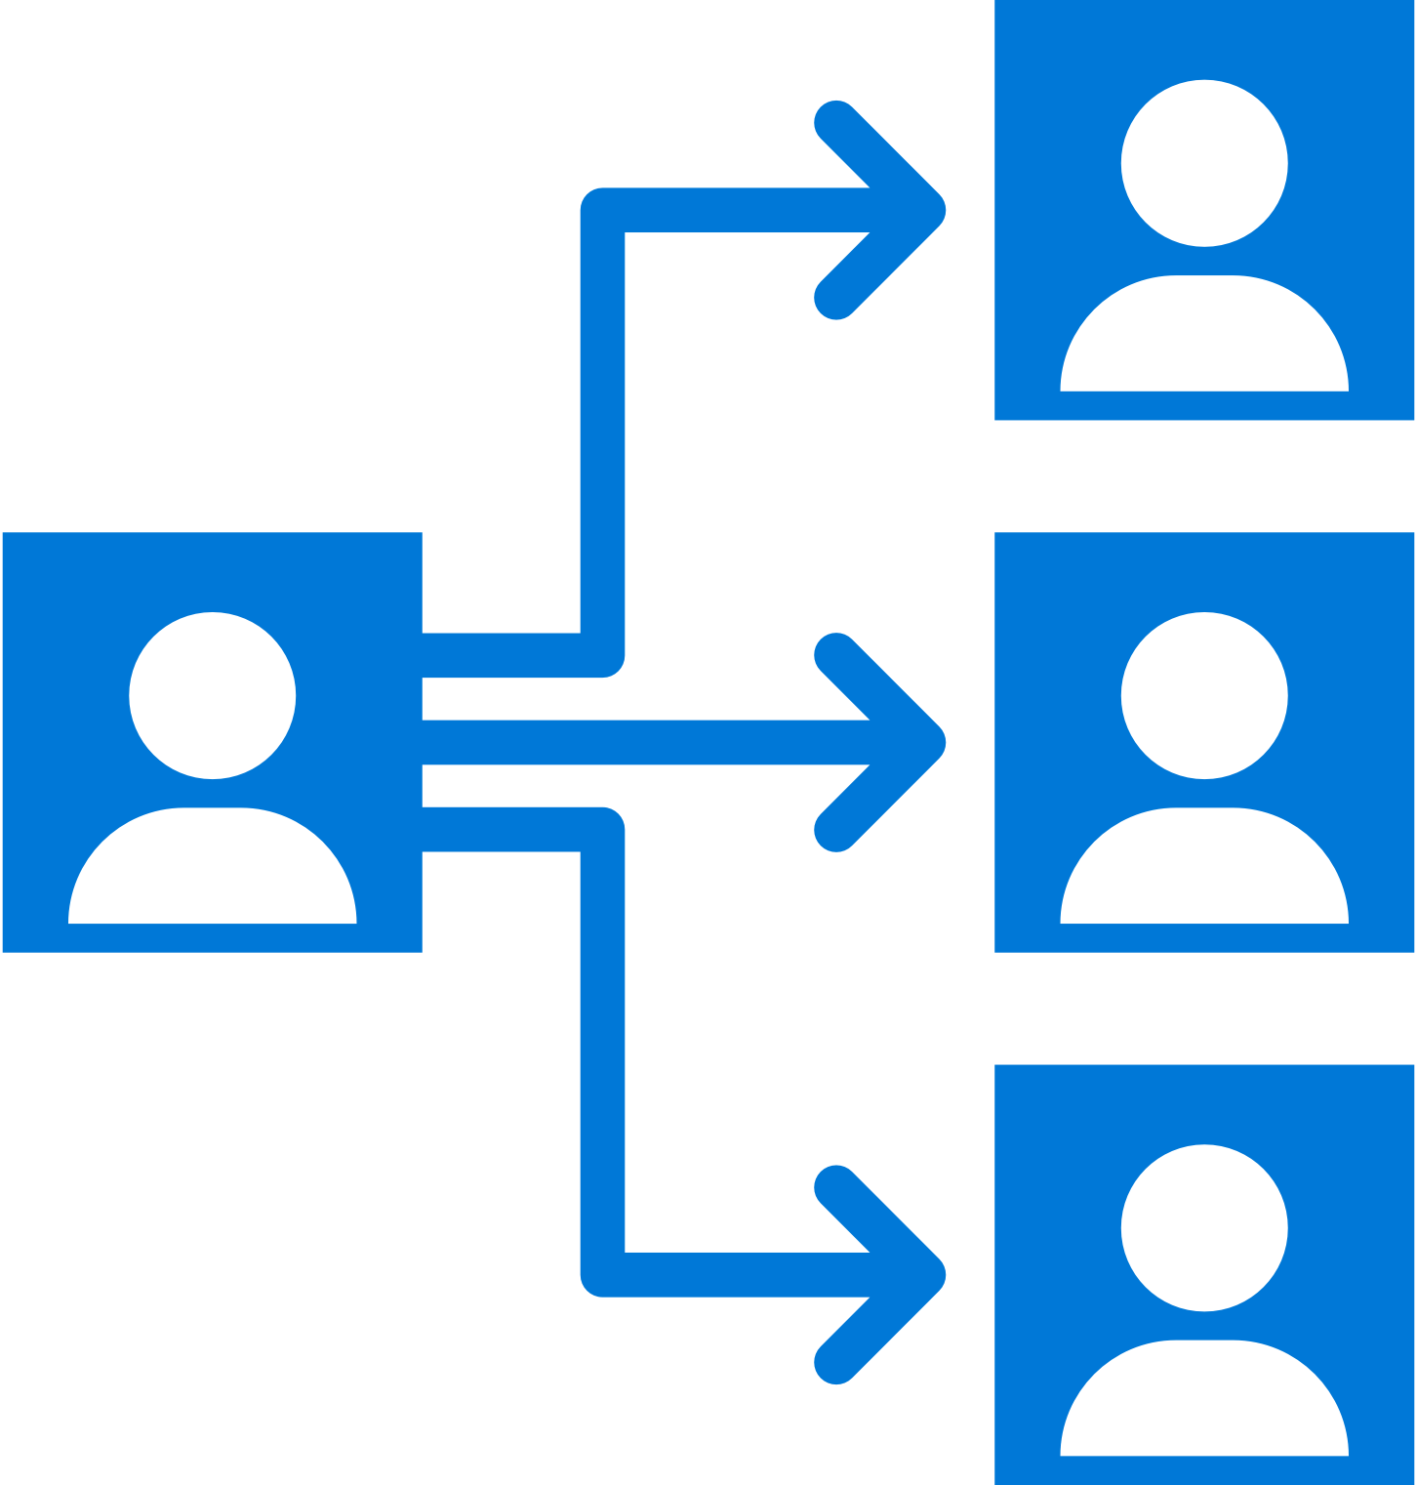
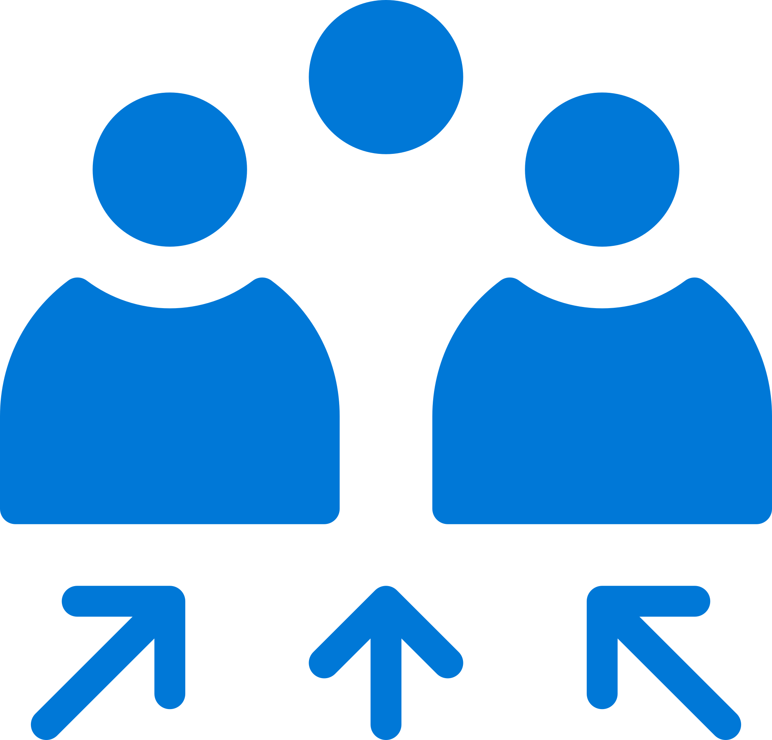
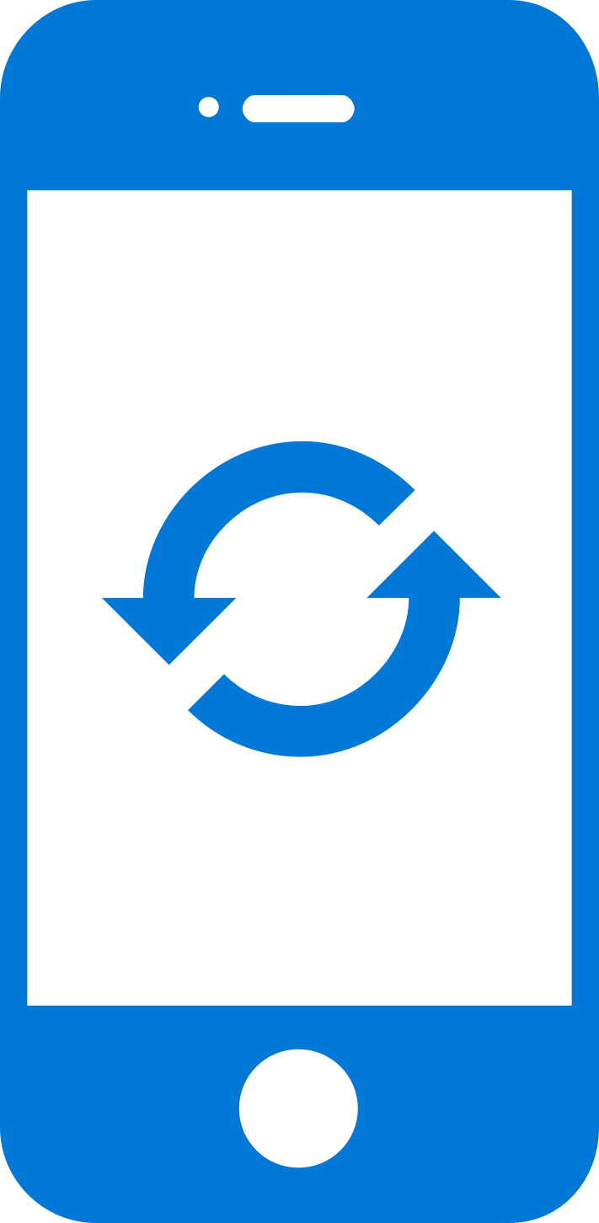
Continuous Everything : Deploy
Instantly distribute apps
Quickly get apps in the hands of your beta testers on multiple device platforms
Create targeted distribution groups
With categorized groups of users, send specific builds to specific groups and devices
Send in-app updates
Notify beta testers as soon as a new build is available, right inside the app
Notes:
Once you have built and tested your app, you probably will want to distribute it to testers at some point. With Mobile Centers distribution offering you can create distribution groups, both for internal private users or public groups and send your app to them for live updates. You also have the ability to publish directly to the public stores like Google Play and Itunes Connect once you are ready to do so.

Slide 11
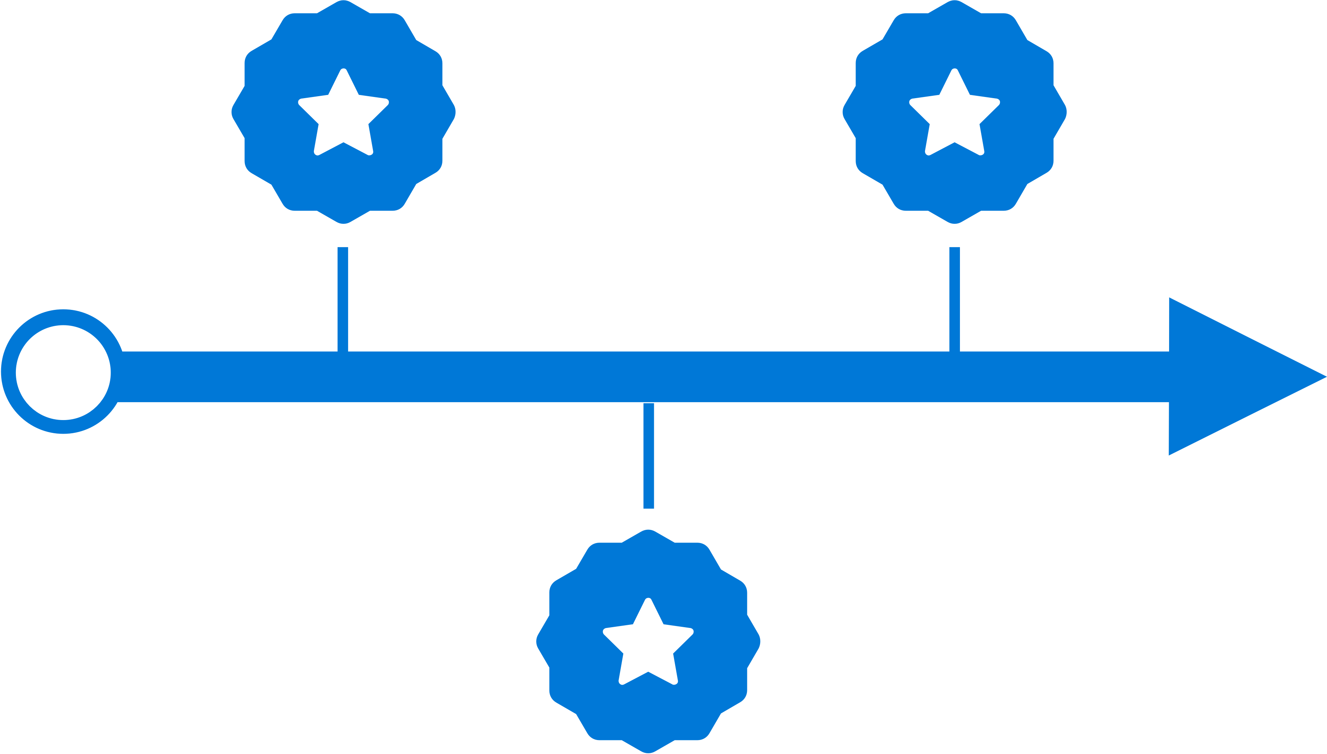



Continuous Everything : Learn
Ship consistent quality
Diagnose crashes fast for maximum uptime and maintain high quality
Get real-time insights
Monitor your app health with real-time crash reports to diagnose and fix problems quickly
Do smart troubleshooting
Crashes are grouped together by similarities to focus on the most critical groups
Easily analyze data
Get detailed, easy-to-read stack traces and logs to quickly understand issues
Notes:
Once your app is live, we, as developers want to continue to know how our app is doing. With our crash service, you can get live stack traces and crash reports from the field, all consolidated in our portal. You will also know details live OS and device type, and crash frequency, and integrate with your bug tracker when crashes occur so you can know and prioritize issues as they arise.

Slide 12
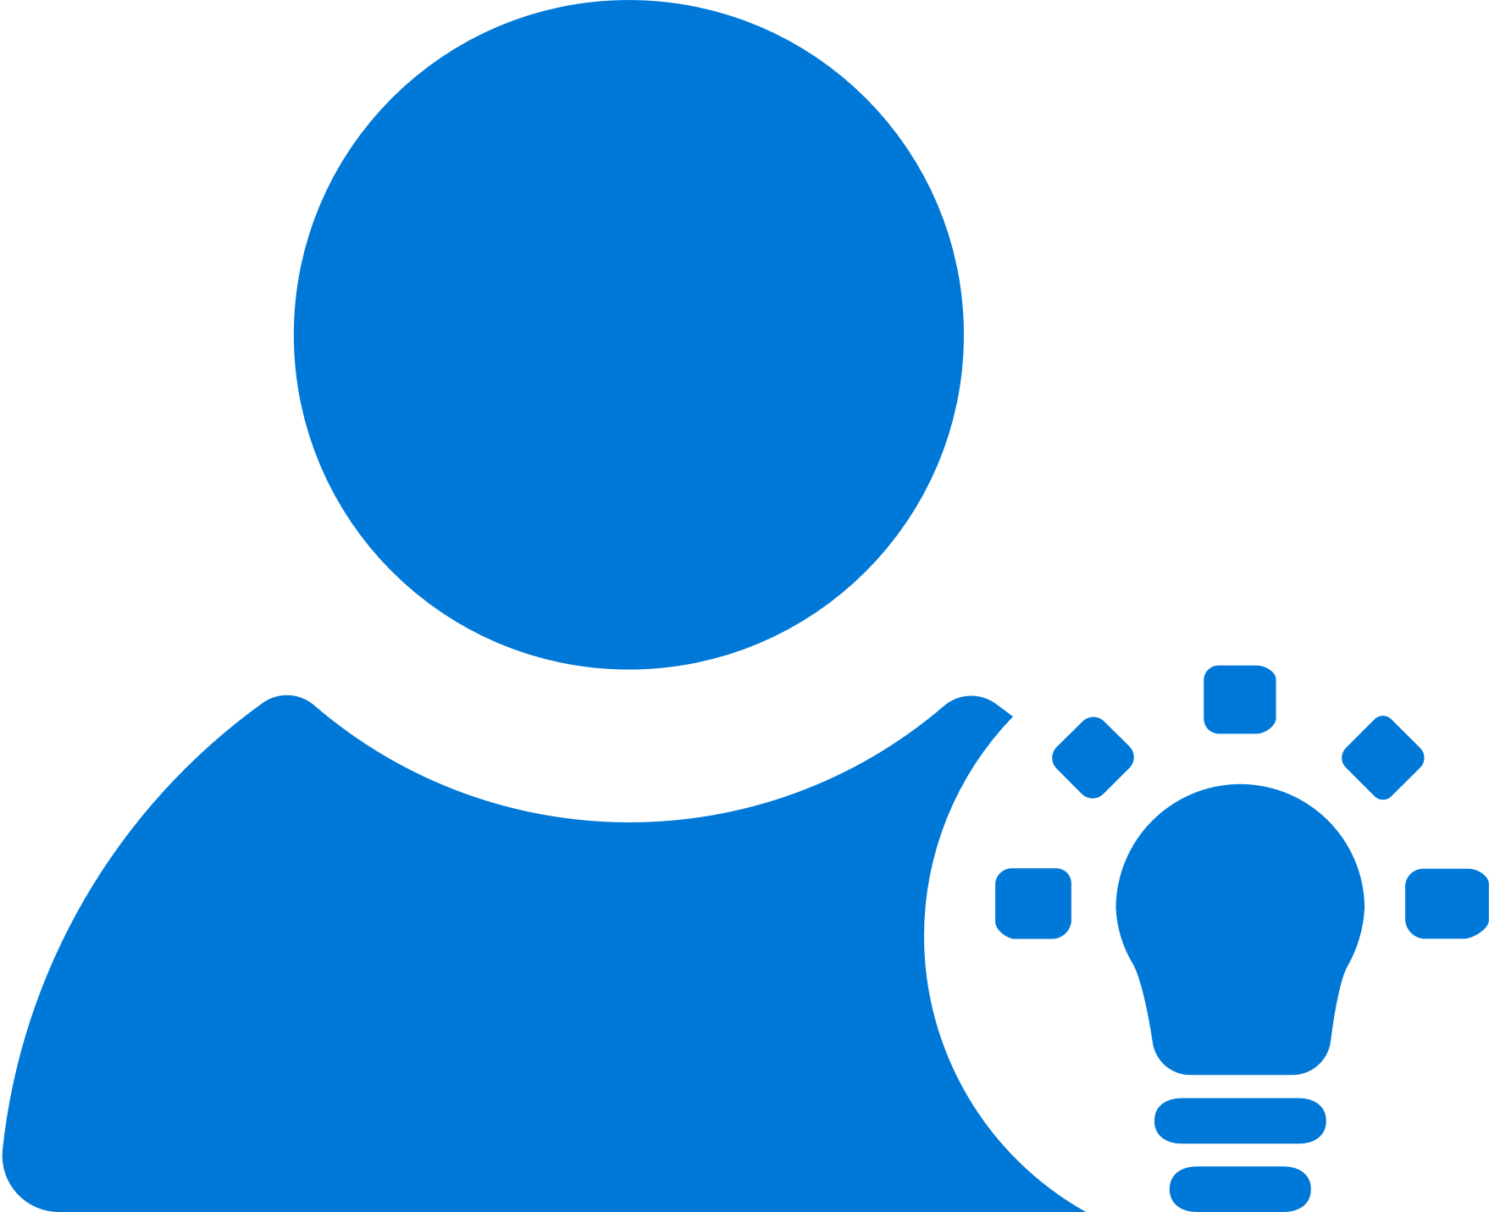



Continuous Everything : Learn
Access instant data
Integrate the analytics SDK in just two steps to start instantaneously seeing data from your app
Understand your customers
Real-time app usage data about your core audience—devices, locations, session info, and more
Build what users want
Analyze the data to see how customers use your app and accordingly prioritize and build new features
Learn more faster
Use custom events to follow users’ actions through your app to analyze their likes and dislikes
Notes:
Along with Crash, many developers want to know more about how their users are engaging with the app. With just a few steps you can start getting immediate information about things like session frequency, adoption rate of releases and even geographic location of your users. All of this can help you learn more and build features your users will love.

Slide 13

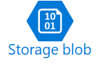
Continuous Everything : Learn
Custom Analtics
Run your own analysis, queries and filtering on your data.
Expanded Storage
Programatically access the raw data, store it indefinitely
Notes:
If you need more from your data, we also support export into both Azure Application Insights and Blob Storage.

Slide 14
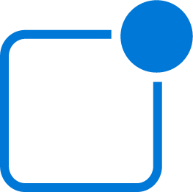
Continuous Everything : Engage
Focused Messaging
Create and send push notifications from a single portal to all app versions
Create Targeted Audiences
Use your Analytics data to create targeted audiences to help tailor messages to specific customers
Notes:
Finally, Mobile Center is also offers support for push notifications. Instead of working through multiple portals to send messages, you can work from a single portal to create targeted audiences and messaging for a more direct connection with your users.

Slide 15
Today’s Agenda
AM
9.30 – 10.30 Setup, Build and Push
10.30 – 10.45 Break
10.45 - 12.00 Testing, Distribution, Analytics and Crash Reporting
PM
12.00 – 1.00 Perficient | Lunch
1.00 – 2.00 Azure Functions
2.00 – 2.15 Break
2.15 – 3.15 Hands on Lab
3.15 – 4.00 Digital Transformation with Azure
4.00 – 5.00 Networking and Prizes

Slide 16

Rob Jewett App. Innovation Specialist Global Black Belt
Notes:
Story: build story have dev team and QA teams in different countries (I’ve worked with customers with teams all over the world)
I don’t have a technical background, and I learned this in a few days, and you can do

Slide 17
Getting Started
Log in to https://mobile.azure.com/
Connect directly with Github, your Microsoft login or new sign-up
Add new App → choose OS/platform
Build:
Select a service
Select Branch
Configure and build
Notes:
How many are Objective C developers?
Java?
React?
Xamarin?
How many of you have tried Mobile Center?
I’ll walk you through getting started, and how to get a build set up
Build: is quick and easy to set up,
Doesn't matter what you use to build your app with (Swift, Java, React Native, Xamarin).
Automatically scans your repo and figures everything out for you.
"Poll of the room who can stand up CI in a week? in a day in am hour.
Docs and APIs link in bottom corner

Slide 18
Mobile Center: Build
Build-on-push
With just a few steps automatically build apps with every commit, and generate packages to test and distribute
Work with existing tools
Connect existing repositories in GitHub, Bitbucket, and Visual Studio Team Services with just a few clicks
Build securely in the cloud
Each build is run on a separate, clean virtual machine hosted on our secure cloud servers
Notes:
Each build is run on a separate, clean virtual machine and no other user has access to this virtual machine. Once the build is completed, the virtual machine is discarded and all files removed. The files resulting from the build (log files, application files, symbol files) are stored on Mobile Center servers.

Slide 19

Mobile Center: Push Notifications
Fast and easy to setup
Just a few lines of code in your app. No need to specify format for iOS, Android and Windows.
Send to specific audiences
Target push notifications to specific users or devices
Fast and easy to send
Three easy steps: Compose, Target, and Review.
No need for technical skills!
Notes:
Visual Studio Mobile Center Push Notifications is really easy
-Just a few lines of code in your app
-No need to specify format for Android, iOS or Windows
-and I’ll show you how easy it is to target and send notifications to your users
Difference in Push Notifications between Notification Hub and MC

Slide 20


Mobile Center: Push Notifications
push
Push notification services
(Apple and Google)
push
push
Notification
Hubs
Visual Studio
Mobile Center
tokens
Notes:
How many of you are involved in mobile app dev?
How many of your apps have push notifications?
Big point of your mobile apps are to engage user and customers. Push notifications helps do that.

Slide 21
June Cho Enterprise Mobile App Dev App Innovation | Global Black Belt

Slide 22
Why Test on Real Devices?
Verify App Integrity
UI loads as expected on different sized screen
App performs as expected on different CPUs
Accessible UI
Features work as per User Flows
Useable Functionality
Testing as part of CI
Reliable Development Cycle

Slide 23
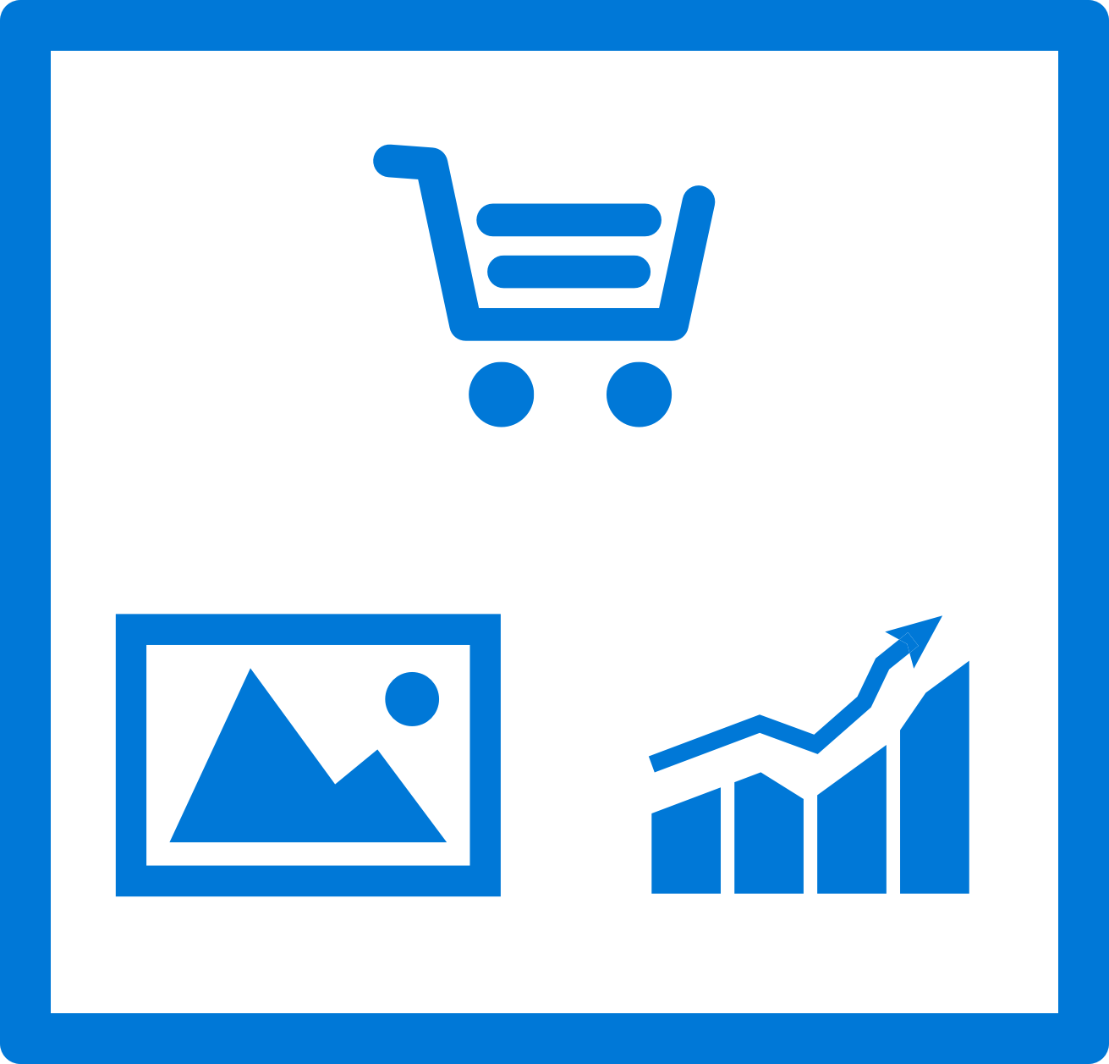
Mobile Center: Test
Release faster
Shrink release times significantly and push new apps out faster
Ship high quality apps Ensure the highest quality user experience that keeps users continuously engaged
Engage a broad audience
Test on a broad range of devices to make sure apps work on your users’ devices
Create new features Spend less time fixing bugs, and more time creating value

Slide 24
Supported Testing Platforms
Xamarin.UITest
Tests written in C#
Supports Xamarin apps, Native (Android, iOS) Apps, React Native Apps, Hybrid Apps
XCUITest
Tests written in Swift
Supports native iOS apps
Espresso
Tests written in Java
Supports native Android apps
Appium
Tests written in Java
Supports native (Android and iOS) apps , Xamarin Apps, React Native Apps, Hybrid Apps

Slide 25
Mobile Center: Distribute
Instantly distribute apps
Quickly get apps in the hands of your beta testers on multiple device platforms
Create targeted distribution groups
With categorized groups of users, send specific builds to specific groups and devices
Send in-app updates
Notify beta testers as soon as a new build is available, right inside the app

Slide 26
Getting Started
Distributing with Mobile Center is easy, and only requires a few steps:
Add users to grant access to all releases.
Create Distribution Groups to manage access.
Upload a new application release.
Install the release onto your device by clicking on the link in the email.
Enable In-App Updates to help your users stay always on the latest release.

Slide 27
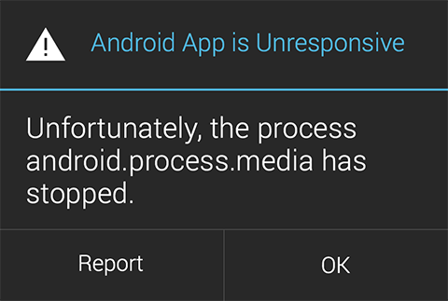
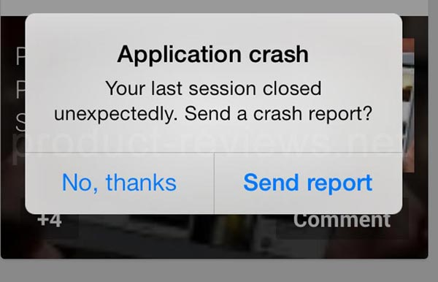

Slide 28
Mobile Center: Crashes
Ship consistent quality
Diagnose crashes fast for maximum uptime and maintain high quality
Get real-time insights
Monitor your app health with real-time crash reports to diagnose and fix problems quickly
Do smart troubleshooting
Crashes are grouped together by similarities to focus on the most critical groups
Easily analyze data
Get detailed, easy-to-read stack traces and logs to quickly understand issues

Slide 29
Mobile Center: Analytics
Access instant data
Integrate the analytics SDK in just two steps to start instantaneously seeing data from your app
Understand your customers
Real-time app usage data about your core audience—devices, locations, session info, and more
Build what users want
Analyze the data to see how customers use your app and accordingly prioritize and build new features
Learn more faster
Use custom events to follow users’ actions through your app to analyze their likes and dislikes

Slide 30
Key Features
Overview
Custom Events
Log Flow
Export to Azure

Slide 31
Sign up free today: mobile.azure.com

Slide 32
Azure Serverless and Functions Overview
Dan Rigby
Technology Solutions Professional
@DanRigby

Slide 33
Why Serverless?
Notes:
All good things begin with a story.
So before I talk to you about serverless, I wanted to discuss some history of how apps have been built through the years and how that has led us to the computing options we have today.
Buy your own hardware and software
Run it in your own data-centers
Deal with a multitude of questions
# of servers
Physical security
Hardware failure
Software patching
Backup
Essentially a lot of questions, not all of which might be directly related to running your business. For example, if you are running an insurance company, you want to spend your time growing and innovating in the insurance domain, not worrying about how to handle servers.

Slide 34
The evolution of application platforms
On-Premises
IaaS
PaaS
Serverless

Slide 35
What is the right size of
servers for my business needs?
How do I deploy new code to my server?
What media should I
use to keep backup?
What happens in case of
server hardware failure?
Which packages should be on my server?
What size of servers
should I buy?
Who monitors
my App?
How often should I backup my server?
How can I scale my app?
How can I increase server utilization?
Who has physical
access to my servers?
Which OS should I use?
Do I need secondary network connection?
Are my server in a
secure location?
What happens if the
power goes out?
Who monitors
my Servers?
Do I need a UPS?
What storage I need to use?
How many servers
do I need?
How can I dynamically configure my app?
It takes how long to provision a new server?
How often should
I patch my servers?
On-Premises
The “evolution” of application platforms
Notes:
All good things begin with a story.
So before I talk to you about serverless, I wanted to discuss some history of how apps have been built through the years and how that has led us to the computing options we have today.
Buy your own hardware and software
Run it in your own data-centers
Deal with a multitude of questions
# of servers
Physical security
Hardware failure
Software patching
Backup
Essentially a lot of questions, not all of which might be directly related to running your business. For example, if you are running an insurance company, you want to spend your time growing and innovating in the insurance domain, not worrying about how to handle servers.

Slide 36
What is the right size of servers for my business needs?
How can I increase server utilization?
How many servers do I need?
How can I scale my app?
How often should I patch my servers?
How do I deploy new code to my server?
How often should I backup my server?
Which OS should I use?
Which packages should be on my server?
Who monitors my App?
On-Premises
IaaS
The “evolution” of application platforms
Notes:
Along came the cloud, and provided some relief from some of those questions.
IaaS in the cloud, allowed you to forget about managing all that physical hardware. Instead of hosting it yourself, you could now utilize servers hosted by someone else. While the worries around managing physical infrastructure are gone, there are a number of questions that still need to thought about:
How many virtual machines do I need?
How many would I need in future when my usage grows?
How to handle updating the servers for the latest security patches
How to think about deploying my code and the various dependencies, such as application runtimes, to the server
Who monitors my apps and so on
This means that you still haven’t reached that ideal state where you could focus purely on your business and its problems.

Slide 37
What is the right size of “servers” for my business needs?
How can I increase “server” utilization?
How many “servers” do I need?
How can I scale my app?
On-Premises
IaaS
PaaS
The “evolution” of application platforms
Notes:
Well, the cloud continue to help with that problem and with the advent of PaaS, there was even more simplification. PaaS allows you to just worry about your app, and let the cloud vendor take care of not only the physical hardware, but also the ongoing management of the operating environment like Operating Systems, Virtual Machines or Containers, as well as the various application runtimes, whether it is Java Runtime, .NET, Node.js, and so on.
You are not completely free from thinking about servers however, since you still have to worry about how to scale your app and accordingly specify the number and size of the various compute resources your apps would need at various times.

Slide 38
How do I architect my app?
Serverless, the platform for next gen apps
On-Premises
IaaS
PaaS
Serverless
The “evolution” of application platforms
Notes:
The latest in this series of evolution is Serverless – which further abstracts the underlying infrastructure from you, and allows you to focus only on a single question – how are you going to build your app to achieve the best results for your business, or whatever it is that you are trying to do with your apps.
Whether it is the code to delight your customers through a great experience, or the logic to communicate securely with a business partner, that is where most organization want to spend their creative energies on.
And serverless allows you to do just that, focus on your code and forget about the infrastructure.
This is why we believe it is the platform for next generation of apps.

Slide 39
What is Serverless?
$
Abstraction of servers
Event-driven/ instant scale
Micro-billing
Notes:
Abstraction of servers:
Complete freedom from thinking about provisioning, maintaining or scaling any server or infrastructure aspects
Event-driven/instant scale:
Ability to handle any volume of traffic without explicit configuration
handle sudden jump from 0 execution to tens of thousand of executions seamlessly
Micro-billing:
Paying only for what you use
You pay only for the amount of time your code runs and the amount of resources it consumes during that period
Never pay for idle capacity

Slide 40
Benefits of Serverless
Manage apps not servers
Reduced DevOps
Faster time to market
Notes:
Manage apps not servers:
Focus on your app logic. If you are an insurance company, you want to be spending your time on providing a great customer experience and maybe optimizing the claims approval process.
You don’t want to worry about servers. It is now possible
Reduced DevOps:
Since you are no longer required to worry about scale, availability, deployment etc., your effort towards non-core activities goes down significantly
Serverless architecture leads you down something we call a “pit of success” by providing a model where components are small and decoupled by design thereby reducing integration challenges
Faster time to market:
Time saved leads to faster app building
Serverless also provides an easy and cheap way to do experimentation – thereby allowing for faster iterations and prototypes

Slide 41
Serverless application platform components
Functions
Execute your code based on events you specify
Notes:
Thank you Chris. Good after noon everyone. Very excited to be here to talk to you about why exactly it is that Microsoft would just not stop talking about this serverless thing – whether it is our CEO or just us measly product managers.
Now the concept that I want to talk about is that of a platform, not an individual service, but a collection of fully managed services that come together and allow you to build serverless applications.
When we talk about serverless, the first thing that obviously comes to mind is Functions-as-a-Service. Basically the ability to execute custom code, on demand, without having to worry about where the code is executing, or how it would scale if the demand goes up. This is what Azure Functions does for you. We will go into details later but that is the basic thing to remember.

Slide 42
Serverless application platform components
Logic Apps
Functions
Design workflows and orchestrate processes
Execute your code based on events you specify
Notes:
Now let me talk about Logic Apps. How many of you have heard about Logic Apps? This service was actually introduced before Functions. And I want to talk about why this service is an important part of the serverless story.
Imagine you are drawing a flowchart that represents a certain process in your business. For example - when a new customer record is created in my CRM system, go ahead and create a project in my project management system, and then send a notification email to these 3 people. We need to have processes like these all the time.
What if you could just convert these flowcharts, with a few clicks of your mouse, into real applications that actually do those things?
Azure Logic Apps effectively does that for you. Through a visual design experience, you can create workflows, that could have multiple steps. And each step could be performed by a different first party or 3rd party service, or even an Azure Function that you might have written.
And goes without saying that you don’t have to worry about where all of this processing is happening – a server, a VM, a container or whatever else. You focus only on the what, not on the how.
In a way this experience is not only serverless, but from a user’s perspective, it is often code-less.

Slide 43
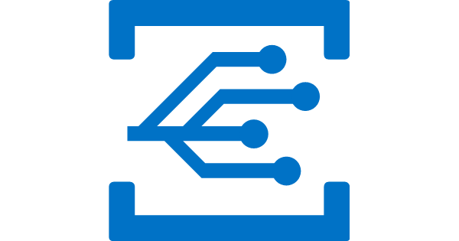
Serverless application platform components
Event Grid
Logic Apps
Functions
Manage all events that can trigger code or logic
Design workflows and orchestrate processes
Execute your code based on events you specify
Notes:
Now lets talk about Event Grid, the latest entry in our serverless toolkit. It is a new service. We announced its public preview last month.
If you think about it, in many ways the popularity of these instant scale, pay as you go compute services can be attributed to the fact that modern computing is all about events. And these events need to be responded to. Whether it is IoT devices sending signals to a central location, users performing some actions on their mobile apps, or even some systems communicating with each other. All of these are examples of event-driven scenarios in which there are certain events that need to be processed.
But how do we manage all these events? This is where Event Grid comes in. This service makes it super easy by providing a single simple interface for managing all your events. Things like:
Where these events are coming from – whether it is a storage change, a database change, a resource being provisioned, or a new user being added to your subscription
And where these events are headed to – whether you need to invoke an Azure Function or an Azure Logic App to respond to this event, or even some other destinations.
We believe that for modern apps an event is an important enough entity that we should make it a first class citizen of Azure, and take away the burden of managing events in either produces or consumers of these events. This is what Event Grid does.

Slide 44

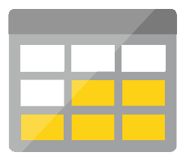
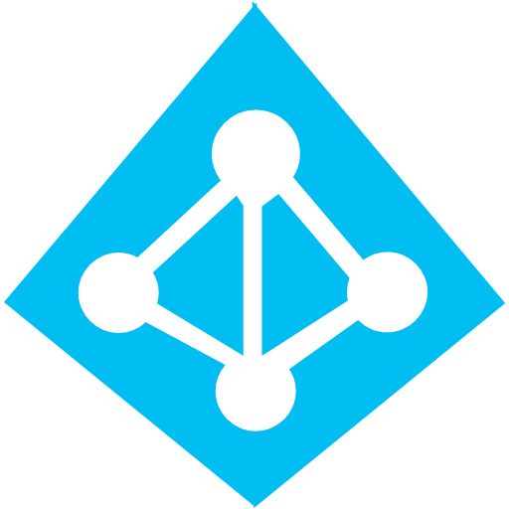
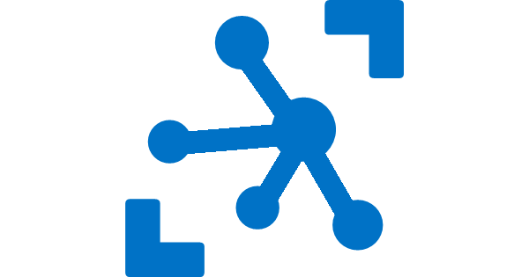

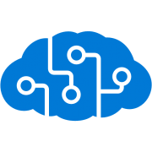
Serverless application platform components
Platform
Event Grid
Logic Apps
Functions
Manage all events that can trigger code or logic
Design workflows and orchestrate processes
Execute your code based on events you specify
Database
Storage
Security
IoT
Analytics
Intelligence
Notes:
OK now that we have the basic building blocks of serverless computing – what do you want to do next?
We are building applications after all. And applications don’t exist in vacuum. They talk to databases, they enable authentication for their users, if it is an IoT app, it potentially receives data from and sends data to IoT devices. Maybe they need to processes that data to prepare it for further analysis, and more and more applications these days are required to have some kind of intelligence in them.
How do we achieve these things in our apps? It wouldn’t be fun if our application code was running in a serverless environment but we still had to manage an army of Virtual Machines to perform these other tasks. We need serverless services for serverless apps. And this is what Azure provides us – we have Cosmos DB, a globally distributed, elastic scale database, a perfect ally for your serverless apps. We have Azure Active Directory (AAD) and AAD B2C for your security and access control needs, IoT Hub solves your IoT needs. You have services like Event Hubs and Stream Analytics to ingest and analyze real-time streaming data. Lastly, we have the Microsoft Cognitive Services API to provide intelligence in your apps.
All of these services together comprise the Azure Serverless application platform. Using these pieces you can compose your applications.

Slide 45

Serverless application platform components
Development
Platform
IDE support
Event Grid
Logic Apps
Functions
Manage all events that can trigger code or logic
Design workflows and orchestrate processes
Execute your code based on events you specify
Integrated DevOps
Local Development
Monitoring
Database
Storage
Security
IoT
Analytics
Intelligence
Visual Debug History
Notes:
So we have a platform now. But how about the process of building these applications? How does the developer experience look like?
How many of you were at the vision keynote yesterday? Satya and his friends – with a combined IQ of 5 million – sitting and talking about Quantum computing. Just like you, I understood everything.
Anyway, the thing that strikes me is this – Quantum computing is in the works, it hasn’t arrived yet. But the programming language, the Visual Studio experience are already here. This is Microsoft. If there is one thing we do right – it is the developer experience. Even in the cloud world, we don’t subscribe to the mentality that just because you are reaping the benefits of running application in the cloud, you can be subjected to pain and heartburn while building those apps.
So for serverless apps, we provide full E2E development experience through tools like Visual Studio and VS Code. We in fact support unique features like the ability to build, test and debug your applications locally on your dev machines, before even deploying them to the cloud. This is a massive productivity boost while building cloud apps and something no other cloud vendor can match. These technologies support continuous deployment so you can easily integrate them into your existing deployment pipelines. And finally, we provide full monitoring support through Azure Application Insights to monitor your apps in production.
So that is how we think of a comprehensive serverless application platform in Azure.
Now, I would like to invite Chris back to do a demo and show some of these services in action. Chris.

Slide 46
Scenarios for Serverless
Anything that needs to respond to events
Real-time stream processing
Timer-based processing
Millions of devices feed into Stream Analytics
Transform to structured data
Store data in SQL DB
Every 15 minutes
Find and clean invalid data
Clean table
Backends (Mobile/IoT/Web)
Real-time bot messaging
?
...
Photo taken and WebHook called
Stores in blob storage
Produces scaled images
Message sent to Chatbot
Chatbot sends
response
Cortana Analytics answers questions
Notes:
So what kind of apps and scenarios can be built using serverless technologies? This is not a trick question because I have already given you the answer.
Anything where there is need to run some code or logic in response to an event. You will notice that this is a very broad definition and covers a vast array of scenarios. So let me provide some examples:
Real-time stream processing: IoT devices sending data that needs to be analyzed, enriched and archived somewhere. This is best done using serverless functions which can be spun up on demand, because you don’t know when the data is going to come in and how much data is going to come in. So, you don’t necessarily want to build your own infrastructure for peak capacity.
Almost every organization needs to run some regular tasks like de-duplication of database entries at the end of every day or collecting logs at the end of every week. Such tasks that need to be run only at specific times and only for a few seconds each time, don’t call for dedicated infrastructure. They are best left to serverless solutions.
Building backends for your mobile, IoT or even web apps is also a popular use-case for serverless architectures: In this diagram you see a mobile app sending an image to a function which stores it in Azure Storage. This action triggers another function which creates multiples thumbnails out of the original image. Being able to perform these action in a serverless manner, takes away the burden of the mobile developer from worrying about the backend.
Bots are all the new rage: Automated response systems receiving a customer request is an event. Building intelligent bots for such scenarios using serverless technology is again a great example where the focus needs to be on logic instead of infrastructure.
These are only some of the many examples which fit well with serverless.

Slide 47


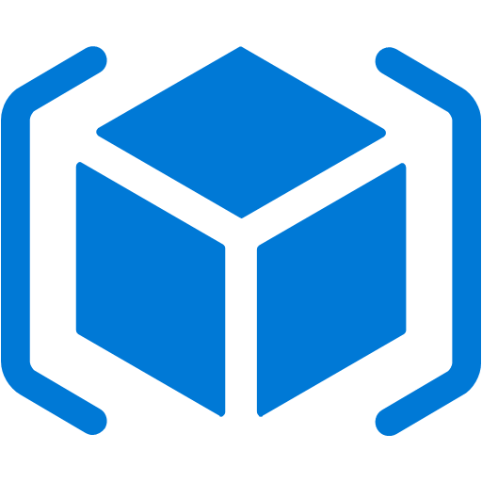

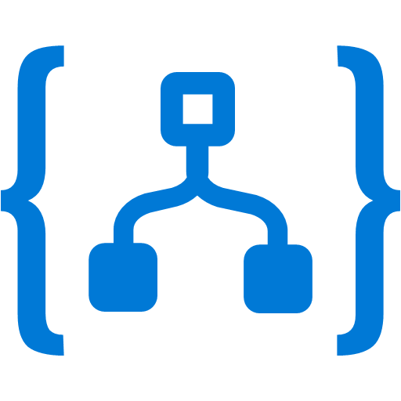


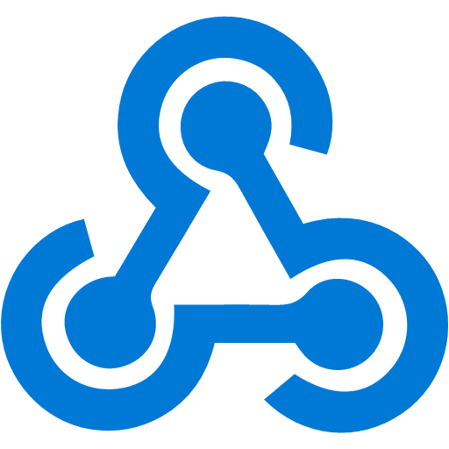

Event Grid
Event publishers
Event handlers
Manage all events in one place
Unlock new scenarios for your apps
Ensure reliability and performance for your apps
Blob Storage
Azure Functions
Resource Groups
Logic Apps
Azure Subscriptions
Azure Automation
Event Hubs
WebHooks
Custom Events
Notes:
Now, I would like to describe the capabilities of our core serverless services, in a little more detail, this time starting with Azure Event Grid.
We already talked about how important events are.
This service allows you to manage all events in a single place
Notice that multiple Azure services today publish their events into Event Grid and these events can be routed to multiple destination. We have Functions, Logic Apps and even other services like Automation and generic webhooks.
You can also create your own customer events
The rich set of publishers and consumers opens up many interesting scenarios for you to construct already. And the list of services that will publish their events to Event Grid will continue to grow over time.

Slide 48
Event Grid delivers at massive scale
Sub-second end-to-end latency in the 99th percentile
10,000,000 events per second per region
24-hour retry with exponential back off for events not delivered
Near real-time
Massive scale-out
High reliability
Notes:
In terms of performance and scale, Event Grid makes some strong guarantees.
Sub-second e2e latency in the 99th percentile, which is as close to real-time delivery as it gets
An ability to route about 10 million events per second, so massive scale
And, an intelligent logic to retry the event delivery if the first time doesn’t succeed
All of these make Event Grid a very powerful event backbone for your serverless applications.

Slide 49
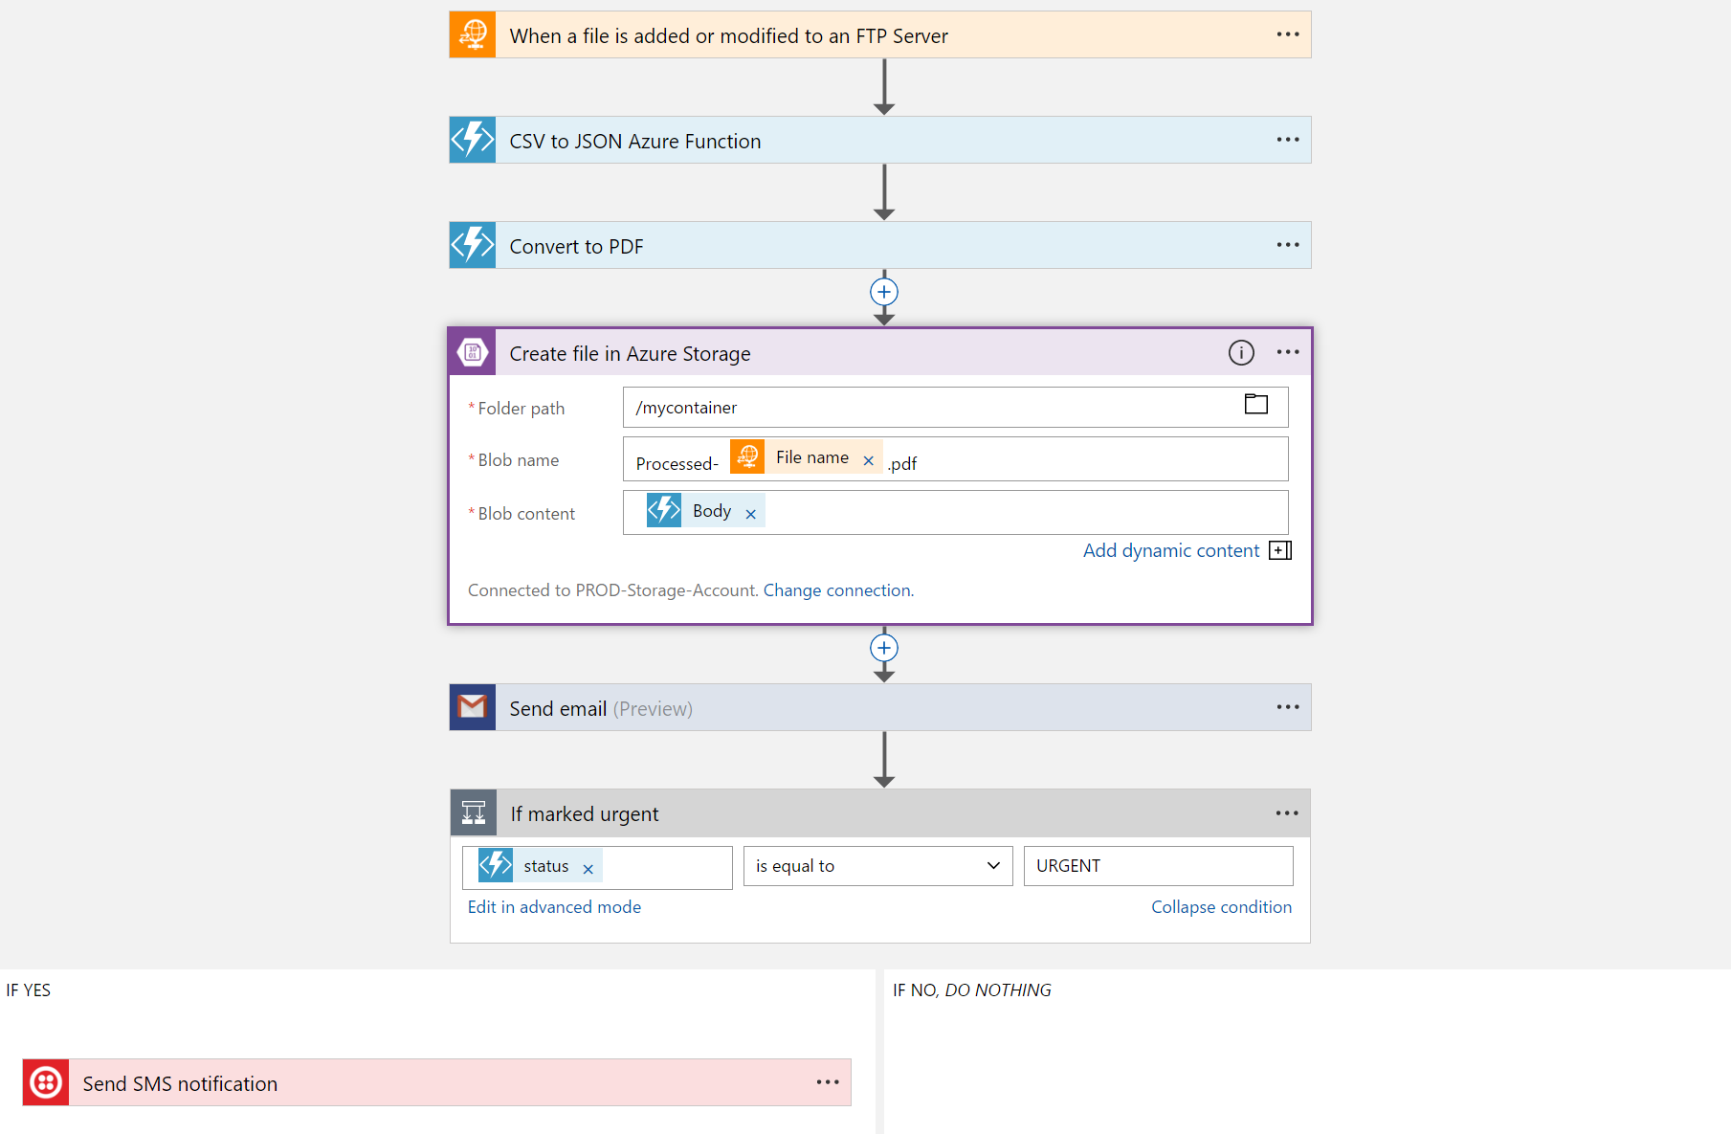
Logic Apps
Visually design workflows in the cloud
Express logic through powerful control flow
Connect disparate functions and APIs
Utilize declarative definition to work with CI/CD
Notes:
Moving on to Logic Apps
Logic Apps is a service that provides a visual design experience for creating serverless workflows in the cloud without writing any code.
No matter how complex your business logic is, you can express it using the powerful control flow available in Logic Apps.
Another key value of this service is that, it provides connections with multiple services and allows you to orchestrate all these services along with the functions which you or someone else in your organization might have written.
Lastly all of these workflows are internally represented using a declarative definition format, again making it very friendly with your existing CI/CD practices

Slide 50
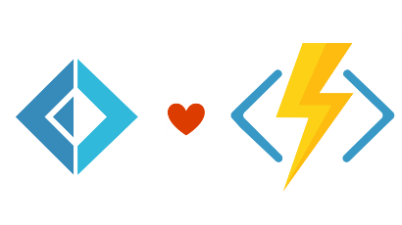


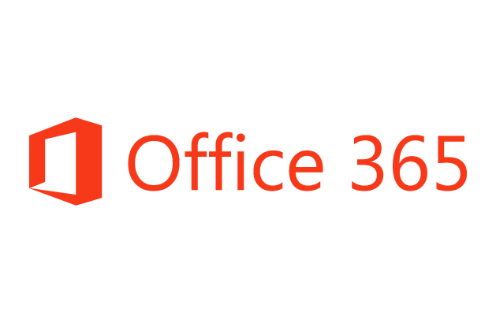
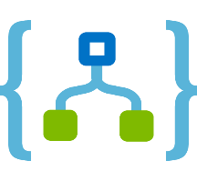
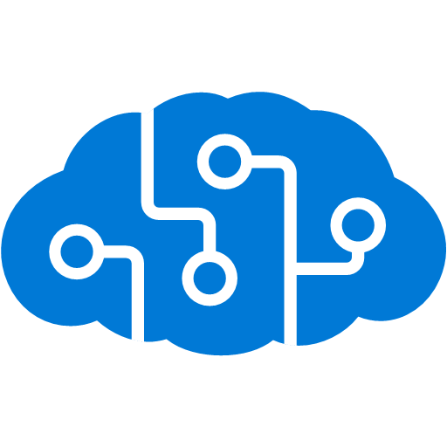
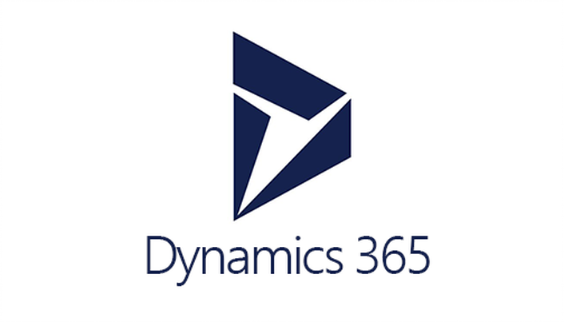



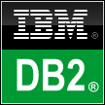
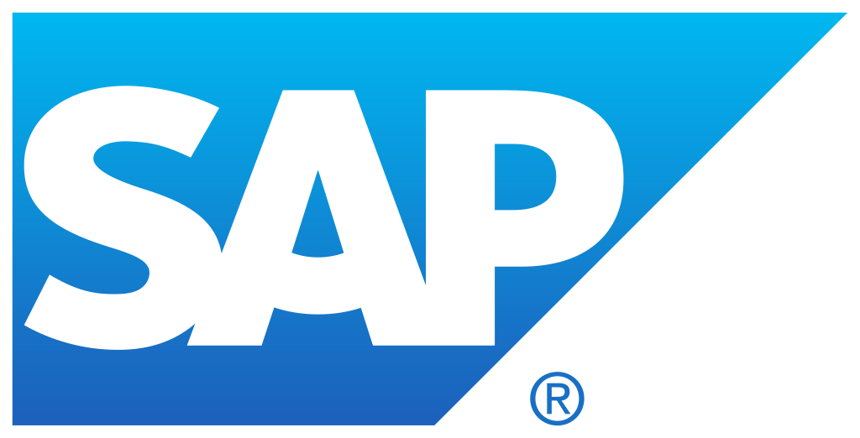


Logic Apps connects everything
Azure Functions
Service bus
Cognitive services
Logic Apps
Machine learning
On-premises data gateway
BizTalk server
Notes:
Logic Apps can integrate with “anything” (APIs) and solve small or complex problems. Automation in a secure and reliable environment fast and easy.
Connect Anything:
On-premises, hybrid and cloud
Mission critical, complex integration scenarios
Business productivity
Agile Business:
Quickly create workflows
Position to the future API centric
Transform Business:
Extract value from both (on-premises and cloud apps)
Build Holistic integration solutions.

Slide 51
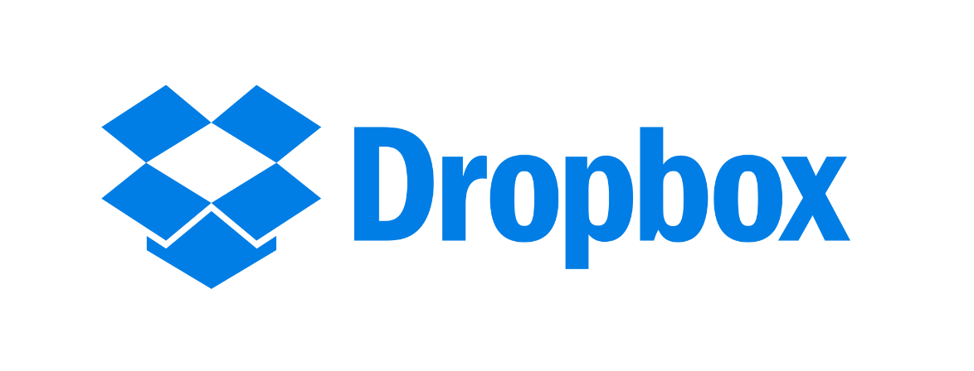

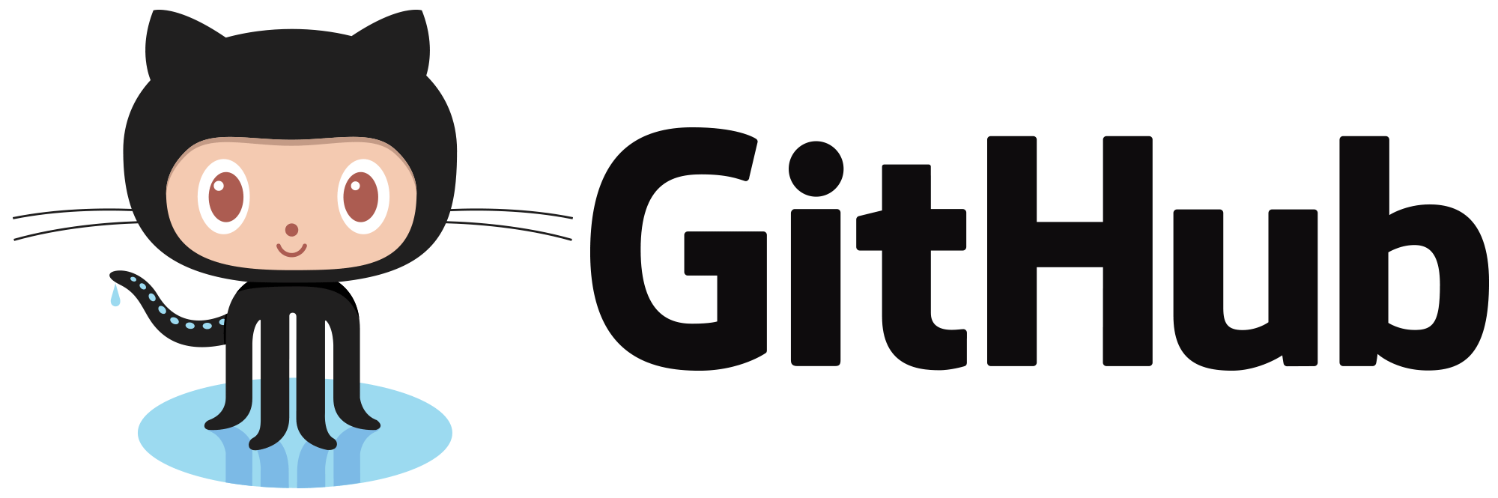
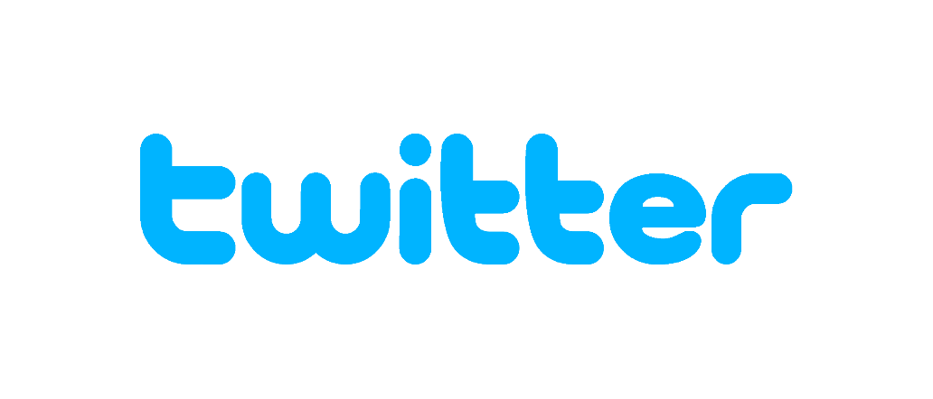
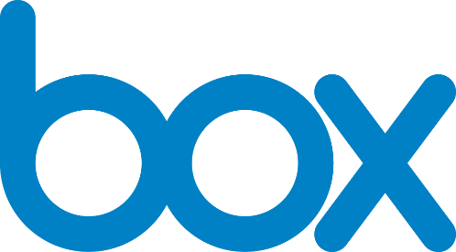


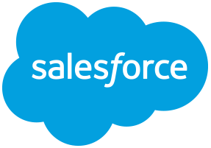
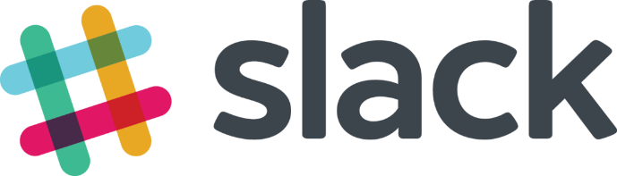
Logic Apps connectors—Over 170 and growing
….and more!
Notes:
Logic Apps support more than 170 connectors already. It goes without saying that it supports most Azure services but you can see from this list that it also supports many popular 3rd party services like Dropbox, Twitter, Salesforce and so on.
And it does that without requiring you to understand how any of these other services work. It completely abstracts the integration details of how to communicate with these other services and their specific API, SDKs and protocols.
And now to talk about the details of Azure Functions, let me call back the person who has been working on this thing before it was a thing. Chris.

Slide 52
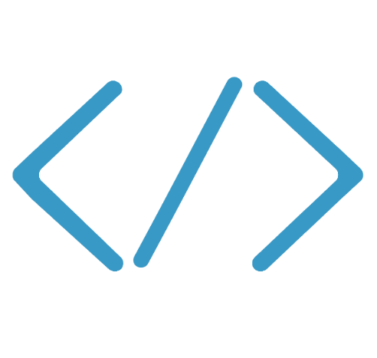

Functions
Code
Azure Functions
Events & Data
Develop locally using best of class developer tools
Boost productivity through triggers and bindings
Choose from a variety of programming languages
Integrate with existing DevOps processes
Notes:
We already saw how Functions provide an experience of responding to events through code that in turn processes data that could be coming from or headed to any number of services. Some of the key highlights are:
Ability to build, test and debug your Functions code locally on your own machine before your code is even deployed to the cloud. This is a massive productivity benefit while building cloud applications and something Azure provides through rich integration with a world class developer tool like Visual Studio
Secondly, unique features like triggers and bindings that make it super easy to setup event-driven architectures and simplify communication with data sources
Thirdly, we support a number of programming languages. In the demo we saw an example with C#. But we also support Node.js, F#, Python and even bash so you can pick the language of your choice to write serverless functions with
Lastly, Functions support concepts such as Continuous deployment, which makes it super easy to integrate them into your existing DevOps pipelines.

Slide 53
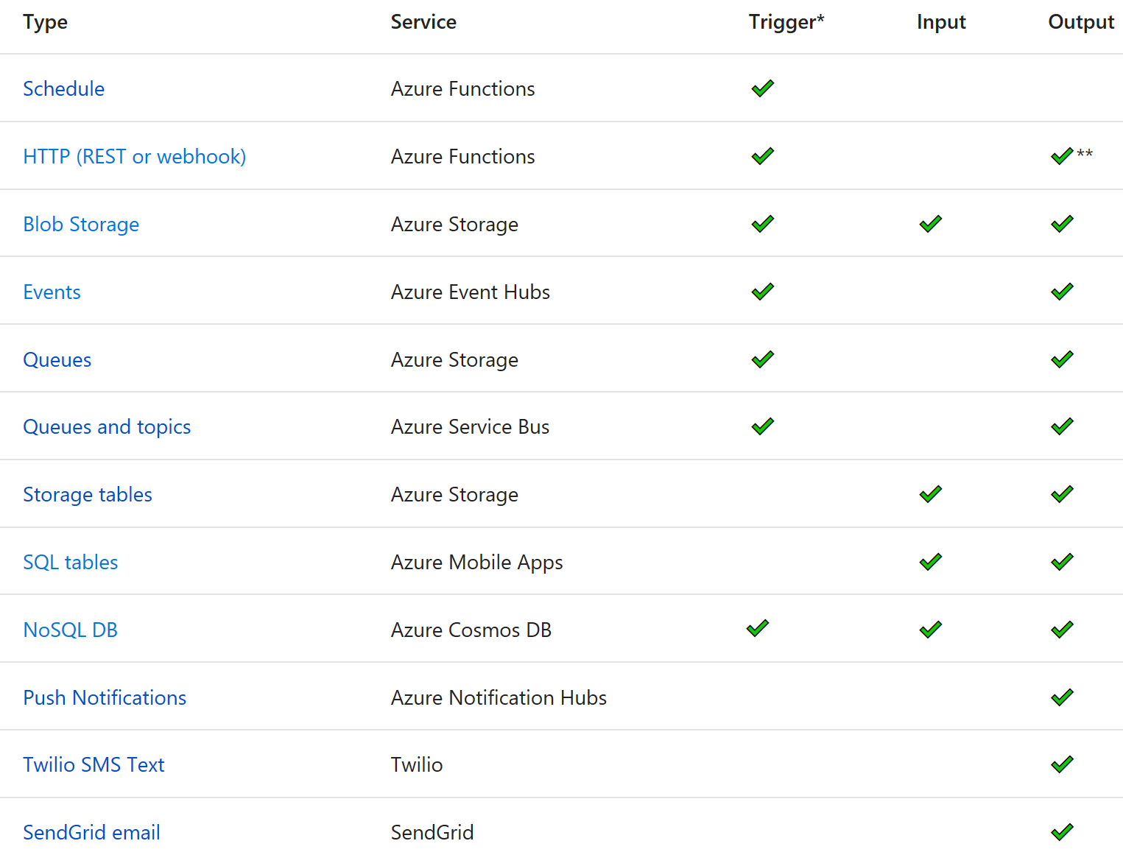
Functions triggers and bindings
Notes:
As I mentioned earlier, triggers and bindings are the things that facilitate easy communication with other services. This chart shows us the triggers and bindings currently supported. As we can see, there are a number of Azure services supported here…. for Storage, Database, Messaging, Notifications and so on. In addition to those, Functions also support generic Http triggers, which means you can easily write a piece of code that can be used to respond to REST requests or requests from any service that supports webhooks. This also provides a really fast and easy mechanism for building extensions to SaaS applications. We are fully committed to making this list grow and making more check-marks appear in that table.

Slide 54


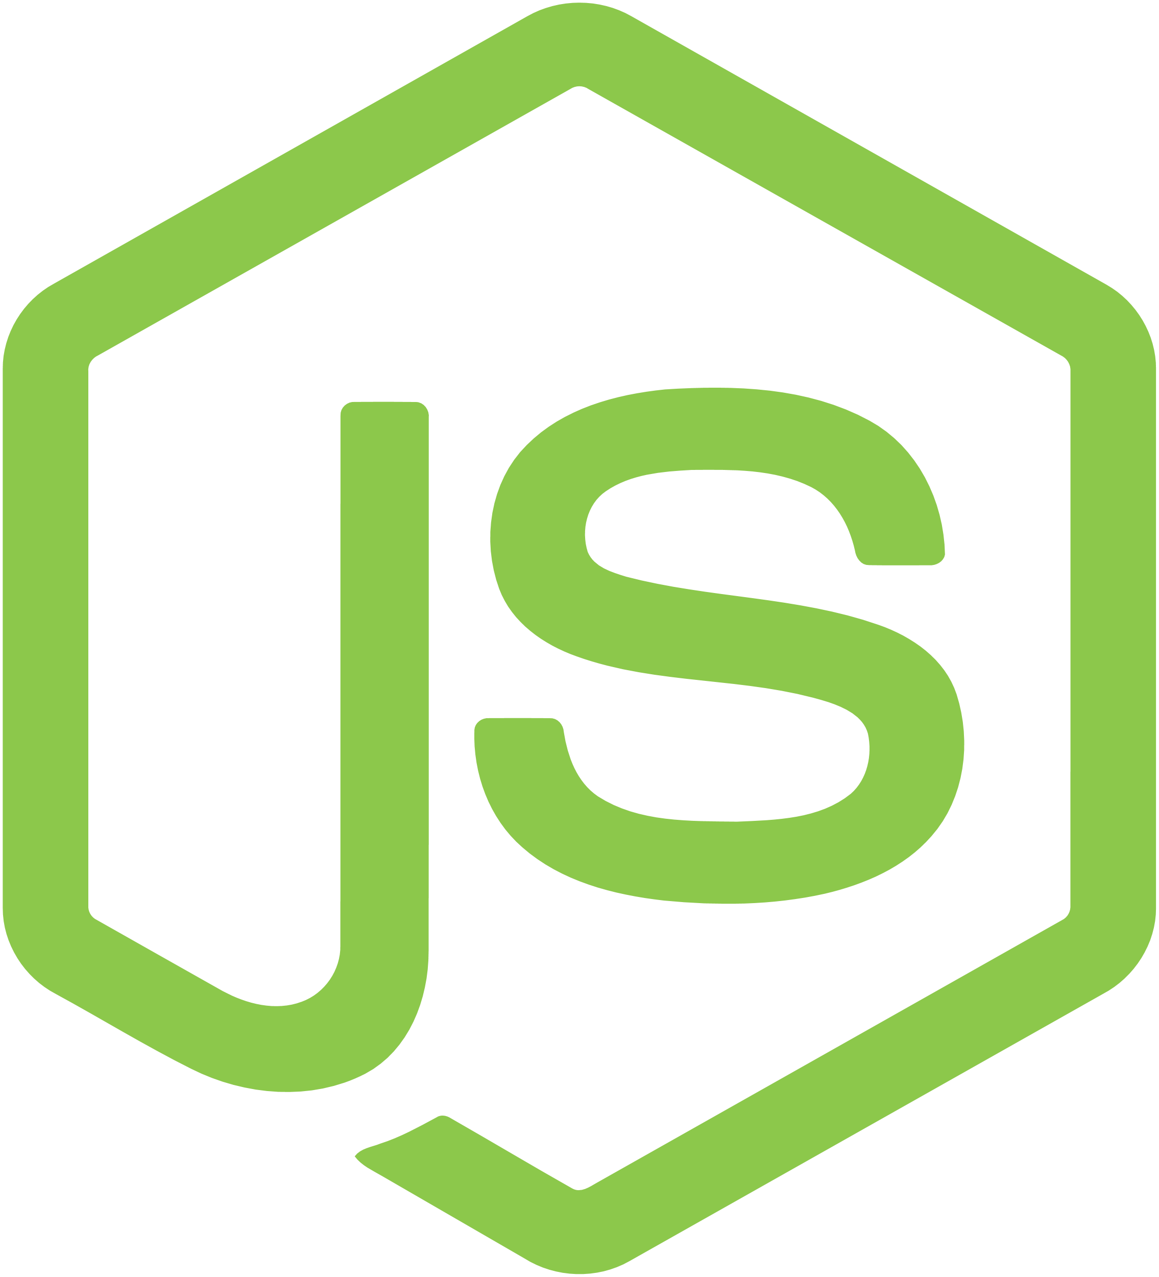



Azure Functions platform features
Development
Languages
Platform
IDE support
.NET
API Features
Visual debug history
Node.js
Bindings
Local development
Scripting (PowerShell, Bash, Batch, Python, PHP)
CI/CD
Verbose debugging
Java
App Service
Notes:
Bindings abstract away where the data is coming to
Logic Apps
Programming free paradigm with a visual designer, drag and drop workflows
With Connectors to different types of services (eg an FTP server)
Talking Points: (Updated on 4/3/17)
Lets talk about what really makes up MSFT’s Serverless platform: At the center of the Serverless platform, is our compute offerings: Azure Functions and Azure Logic Apps. Azure Functions is an event based Serverless compute experience that helps you accelerate your development. Run time is open. Function code can be executed in vm or somewhere else, on prem or in clould. Logic Apps is a powerful orchestration tool. It enables building a Serverless app in minutes – by orchestrating multiple functions using a visual workflow tool.
Say you have your apps up and running using Serverless. Congratulations! You now need to collect intelligence from different apps across platforms to take actions upon. There are a few essential components which we think are core to building Serverless applications are:
Data/ Storage –Functions has triggers and bindings with Azure document DB and Azure Blob storage
** Triggers: Triggers are event responses used to trigger your custom code. They allow you to respond to events across the Azure platform or on premise.
** Bindings: Bindings represent the necessary meta data used to connect your code to the desired trigger or associated input or output data.
Messaging such as queues and topics using Azure Service Bus and Azure Event Hubs
Integration – that includes core LOB apps and SaaS apps integration via Azure Logic Apps.
Intelligence on data and sentiment/ predictive analysis using Cognitive services and Machine learning
Conversation as a service – how do we equip developers to build apps that offer an end-to-end experience for their end users – Azure Bot Service offers a Serverless interactive bot experience.
More, developers are spending more time writing code that allows them to add huge business impact with Serverless. MSFT offers numerous development tools such as IDE Support for Visual Studio in functions and Logic Apps, enables local development (vs web browser coding environment), visual debugging capability, all with your tools of choice.
Lastly, I also want to highlight top scenarios and use cases for Serverless:
Real-time Stream analytics: Customers can use Functions to feed real-time streams of data from application tracking into structured data and store it in SQL online.
SaaS event processing: Customers can use Functions and Logic Apps to analyze data from an excel file in Onedrive and perform validation, filtration, sorting and convert data into consumable business charts
Web app architecture: Used a lot in creating targeted marketing collaterals – when a customer clicks on a webpage, it triggers a webhook, that uses a function to create an ad that matches the customer profile and displays a completed webpage.
Real-time bot messaging: When customers send a message to a chatbox, Functions calls Cortana analytics to generate appropriate answers and sends a response back.
//from before: Customers have different paths to build a Serverless app – start by building the distributed application components using functions by leveraging the numerous templates and declarative bindings Or
Start with the workflow and orchestration of Serverless application using Azure Logic Apps. The visual designer enables developers to quickly and easily author, edit and visualize orchestration of multiple functions and workflow.

Slide 55

What’s new in Azure Functions
Trigger a function based on changes in Cosmos DB
Database
Local Development
Develop functions locally on Linux, MacOS, Windows
Functions
Securely provide access to information in Microsoft Graph through a function
Security
Execute your code based on events you specify
Monitoring
Monitor serverless applications using Application Insights
Trigger a function from a real-time analytics pipeline in Stream Analytics
Analytics

Slide 56
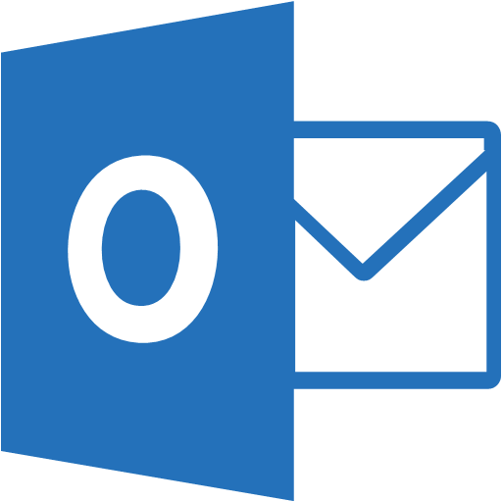
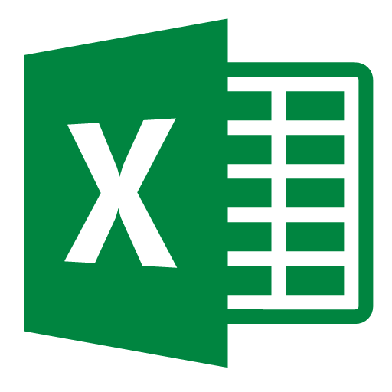
Microsoft Graph bindings for Functions
React to:
Mail messages
Calendar events
Personal contacts
OneDrive items
Read from:
Excel
OneDrive
Write to:
Excel
OneDrive
Outlook messages
+ more with identity support for API calls

Slide 57
Functions + Application Insights
Extensible Application Performance Management (APM)
Rich data: Metrics, Traces, Exception tracking, Dependencies, Page Views, User data, custom events
Easy to use graph/alerts, powerful analytics portal, integration with PowerBI and other analytics services

Slide 58
Demo

Slide 59
In review…
Serverless = focus on your business logic not infrastructure
Event Grid – manage all events in one place
Logic Apps – compose serverless workflows
Azure Functions – author serverless code
Secure access
Work with your data
Integrate with existing business apps
Manage no servers

